Slide 1
REAL ESTATE TECH SYSTEM(RET)
TEAM:
Under the guidance of:
Mrs. Krishnaveni - Assistant Professor
Arun Prasad V (111919205003) Venkat Raj M (111919205048) Subash V (111919205039)
realestatetech@gmail.com
Domain:
Estimate System using Website and App

Slide 2

Abstract
(*)This Sysyem will provide free of cost facility to user to check the price of house and land (*)User can view property in 3D on their device (*)Many functions contains to view all details
about that land
(*)Provide security to both agent and user
RETSYSTEM

Slide 3

EXISTING
SYSTEM
OLX, NOBROKER
LIMITATIONS
Documents verification are not available
Exact location and land details not known properly
High risk of frauds

Slide 4

HARDWARE
Pc and Mobile 8 GB RAM
1.5 TB Hard disk
REQUIREMENT
SOFTWARE
Visual code studio SQL sever Internet Browser OS-Windows

Slide 5

Proposed System
Get verified documents and land detail
In the current system the deatils provided by the customers are not verified by documents ond land
Skilled Agents
A traning couse will be conducted which was developed by the professionals
Priority Search
To give a 100%percent satisfaction that
the client need is satisfied
User friendly
Admins will be availalabe 24/7 to solve your queries

Slide 6
Modules
Description
01
Location based lands
03
Price Estimation
In this module we provide the properties available for sale in that location wised been listed.Users can easily access to buy which type of property of land and willing location to buy.
In this module there was two category listed which is helps us to calculate the land total price and also per sq feet price as per details given by the land owner.
02
EMI Caluculator
04
Technical Support
we have a separte Emi caluclation method which provide them a clear detail the bank loaning process.Also it shows the how much pay monthly wise to settled total amount.
In this module we provide the list of admin and agents contact details to contact any information regarding the location.Also we provide feedback form to fill customers.

Slide 7




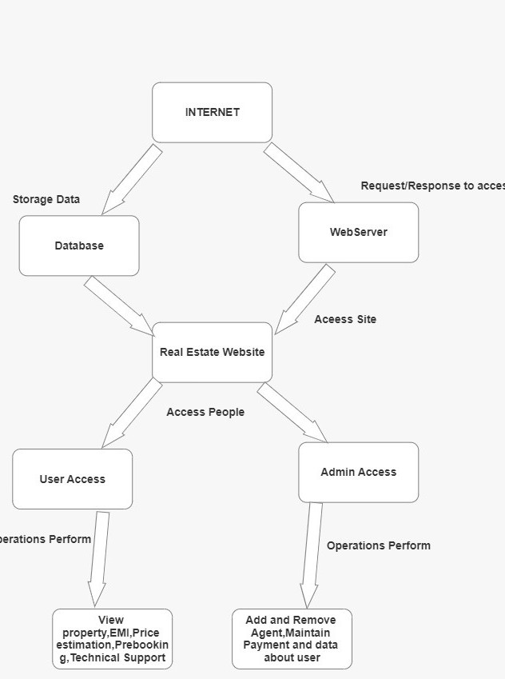
Architecture Diagram

Slide 8
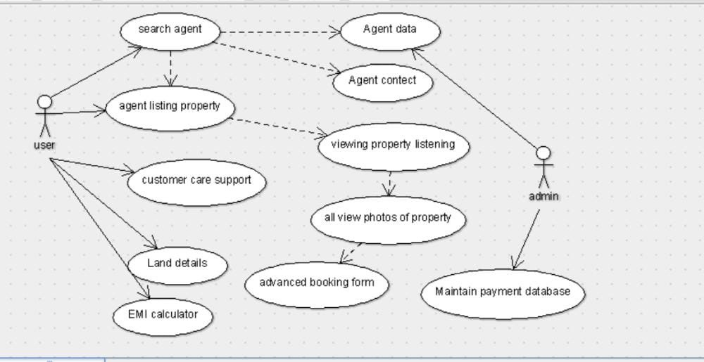

use case diagram

Slide 9
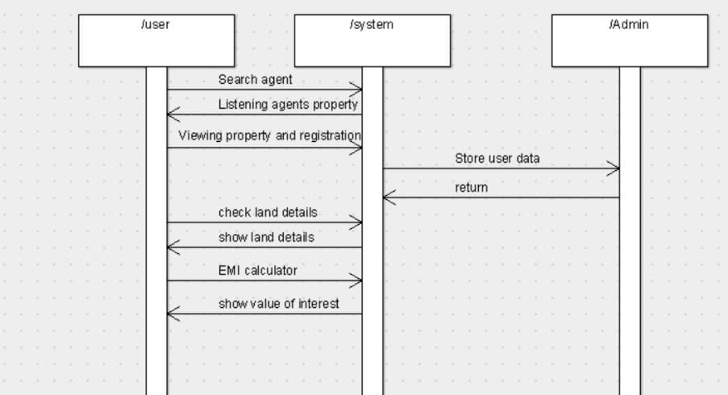
Sequence Diagram

Slide 10
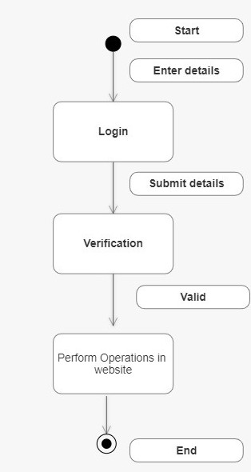
state chart diagram

Slide 11

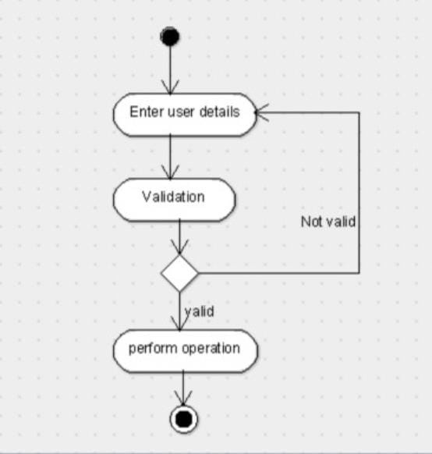
Activity Diagram

Slide 12
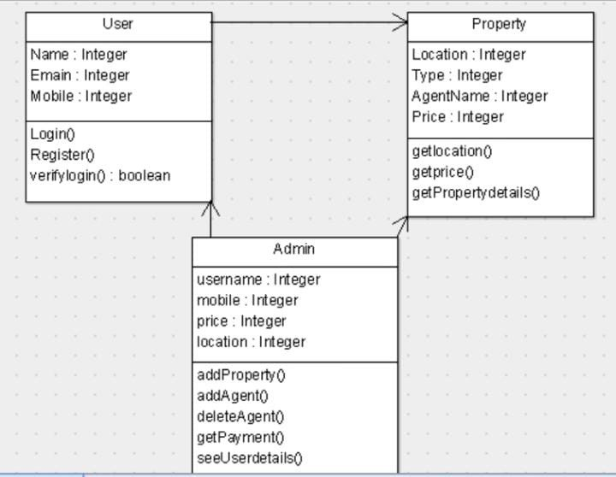
Class diagram

Slide 13
Future
01
vip passes provided them all access to your plan henceforth your team will deal with all access
ENHANCEMENT
To provide a fraud less brokage system in the field and providing a user to easily understand the basic risks in the real estate and helping them for there future
02
preparing to plan a team which helps to build house and demolish the old one to new
03
renting facility will be provided for warehouse and commericals areas

Slide 14
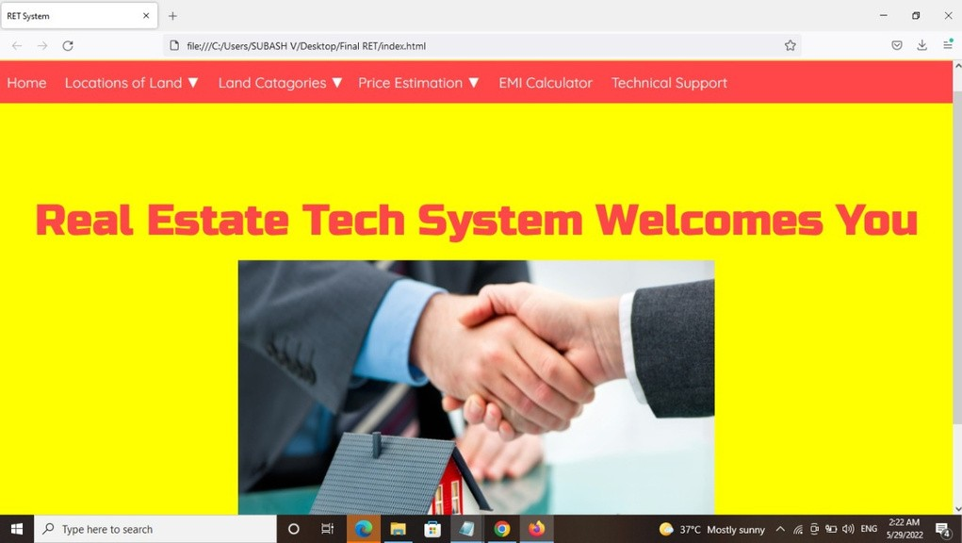
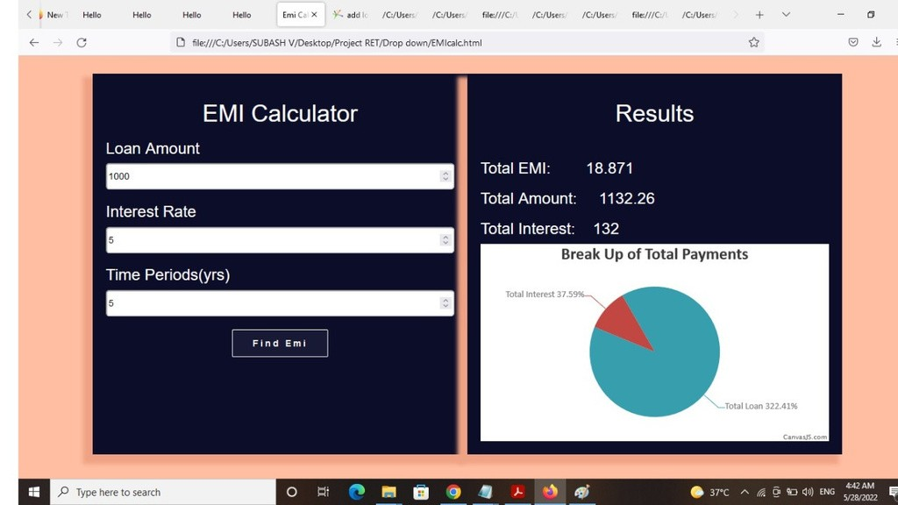
SCREENSHOTS

Slide 15
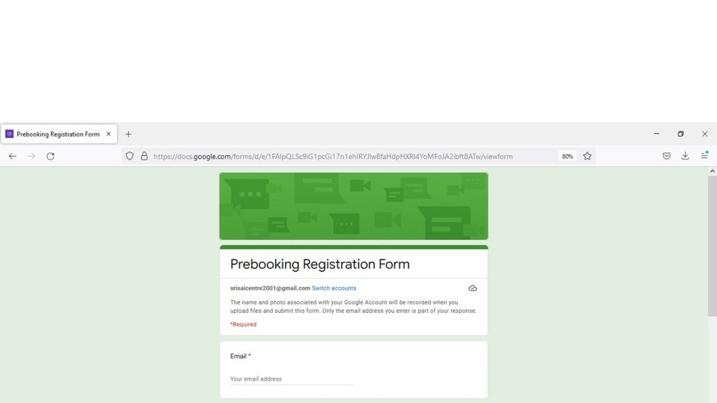
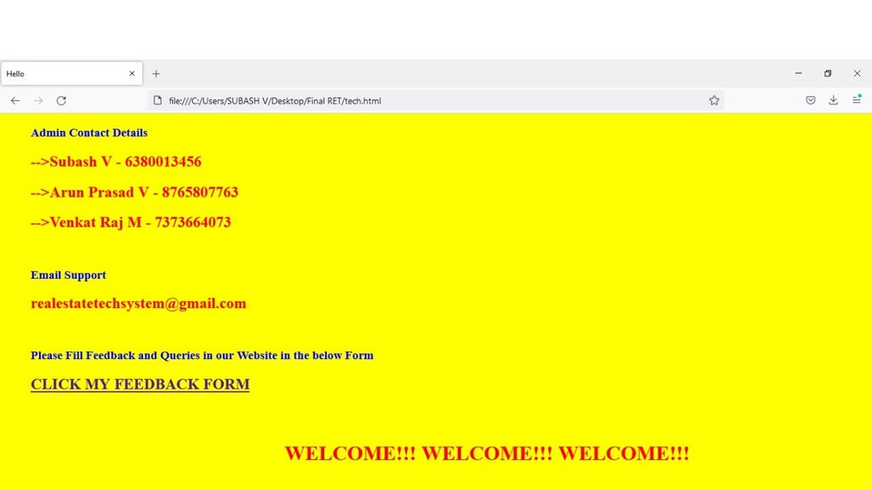
SCREENSHOTS

Slide 16
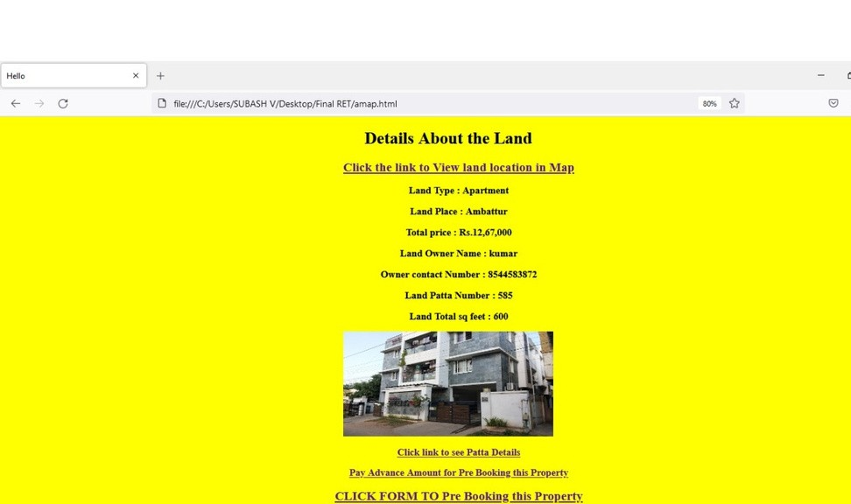
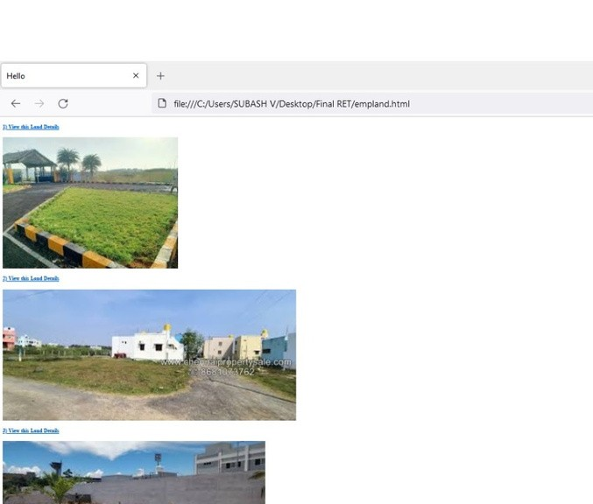
SCREENSHOTS

Slide 17
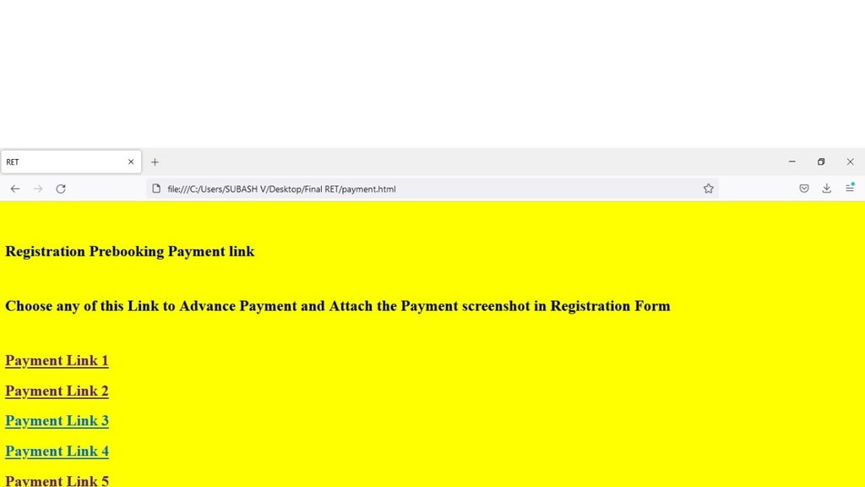
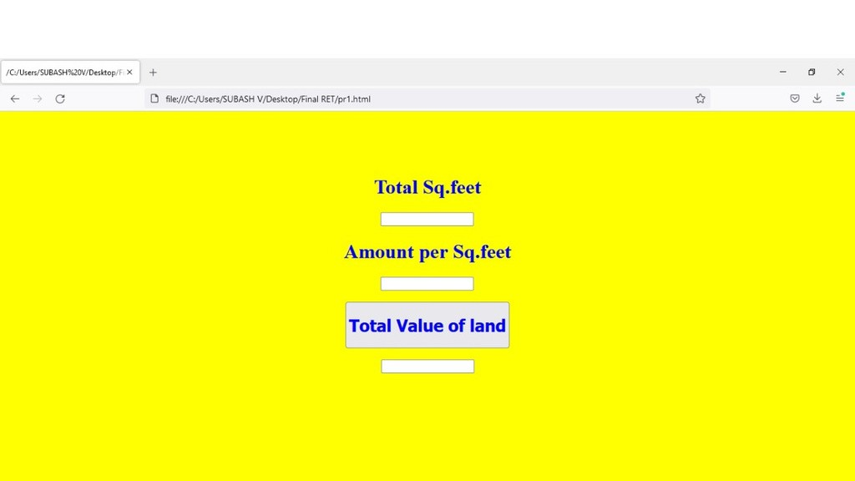
SCREENSHOTS

Slide 18
THANK YOU

